Slide 1


Slide 2
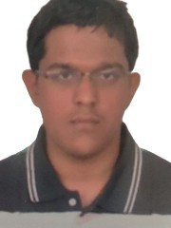


Project Highlights
Project Name : Twitter Sentimental Analysis using Python
Team Size : 3
BU Mentor Name : Adler Mentor PS#20035779
Team Members Details
Intern Name: Sampreeth R
PS#99002500
GENESIS Track Code: 2009BLRMED01
Intern Name:K R Phanindra
PS#99002680
GENESIS Track Code:2009BLRMED01
Intern Name:Chappidi Lokanath Reddy
PS#99002639
GENESIS Track Code:2009BLRMED01

Slide 3
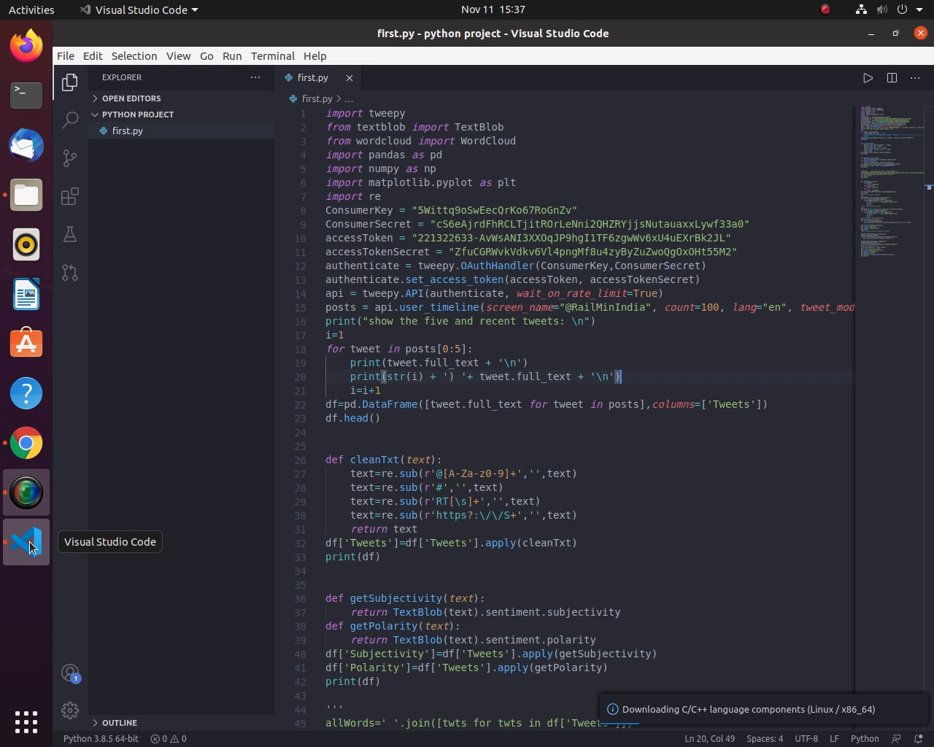
Project Video Snippet

Slide 4
Future development that can be implemented further
→ To make use of unstructured Database such as MongoDB to store the data so that data can be available even when system is offline.
→ To allow users to type the username of required twitter account during run time

Slide 5


Thank You !

